Slide 1
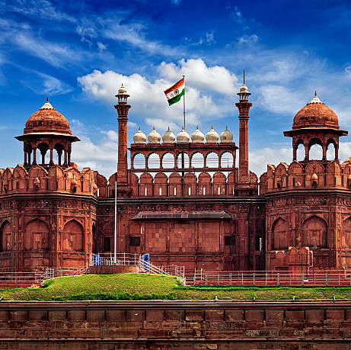
Domestic
Tour & Travel
Presented By
Abranil Kundu
Dipayan Kumar Sarkar
The Heritage Academy
Affiliated to MAKAUT

Slide 2
Content
Introduction
Project Specification
SDLC
User Modules
Admin Modules
Data Flow Diagram (DFD)
ER Diagram
Screen Layout
Future Scope
Conclusion
Bibliography

Slide 3
Introduction
The Domestic Tour and Travel is a PHP-based website designed to assist tourists in exploring and planning trips based on cities, state and different types of places. It optimizes tour itineraries to save time in reaching destinations, allowing users to explore more. The web app's main purpose is to provide a convenient platform for customers to book tour packages for their travel .

Slide 4
Project Specification
Project Title : Domestic Tour and Travels
Institution : The Heritage Academy
Front End Tools : HTML, CSS, Bootstrap, JavaScript
Back End Tools : PHP(lang), MySQL
Web Server : Apache
Web Browser : Chrome, Brave etc.
Code Editor : VS code, Sublime Text
Hardware : 32-bit processor, 2.30 GHz, 2 GB RAM
Submitted By : Abhranil Kundu, Dipayan Kr. Sarkar

Slide 5
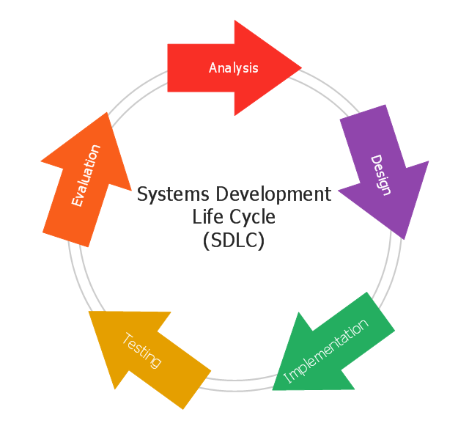
SDLC
SDLC is a process for planning, creating, testing, and deploying an information system, involving analysis, design, development, implementation, documentation, and evaluation stages. It applies to hardware, software, or their combination.

Slide 6

User Modules
User can login with the valid username and password
Update his/her profile
Book Tour
View About Us and others page.
Submit Enquiry
And many other things

Slide 7
Admin Modules
Admin can add/update/ delete tour packages
Admin can also manage the booking application (approve and not approve).
Admin can view all registered users.
Admin can change own password after login.
Admin can also view admin dashboard

Slide 8
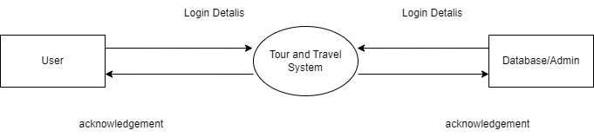
Data Flow Diagram (DFD)
A picture is worth a thousand words. A Data Flow Diagram (DFD) is traditional visual representation of the information flows within a system.
Level 0

Slide 9
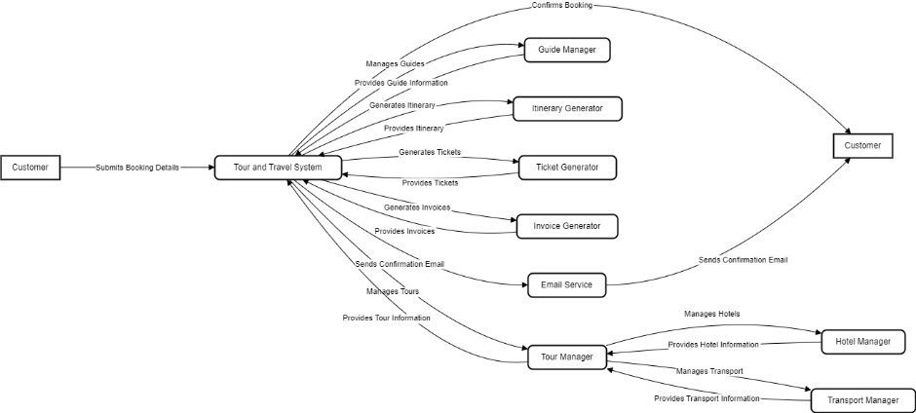
Level 0

Slide 10
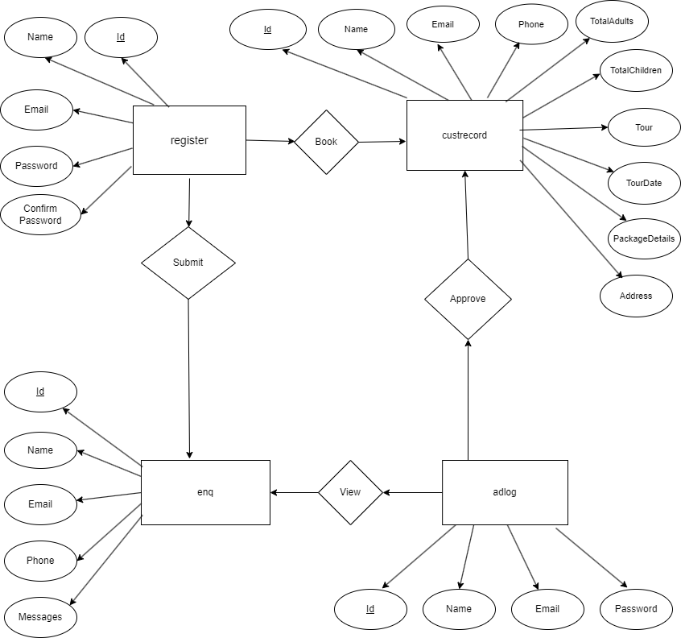
ER Diagram
The ER or (Entity Relational Model) is a high-level conceptual data model diagram. Entity-Relation model is based on the notion of real-world entities and the relationship between them.

Slide 11
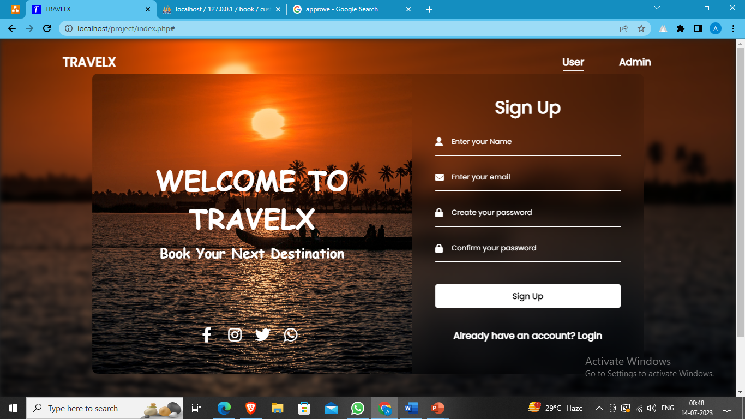
User Interface Design
Sign Up Option

Slide 12
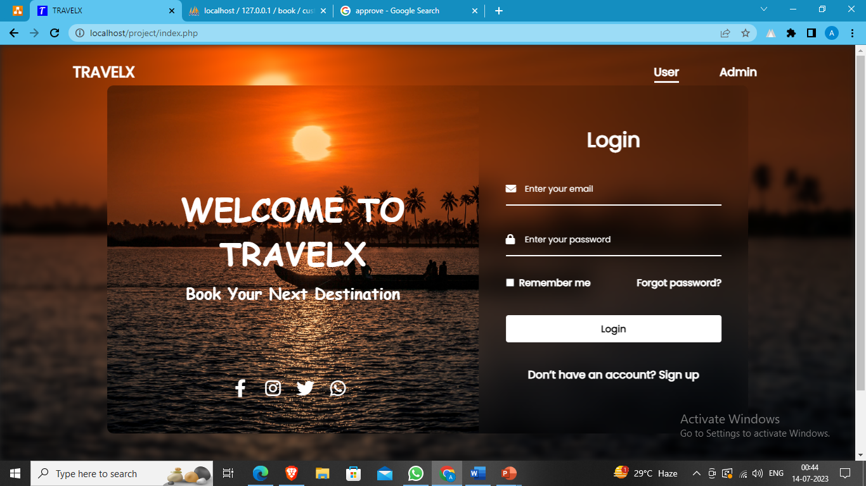
Login Option

Slide 13
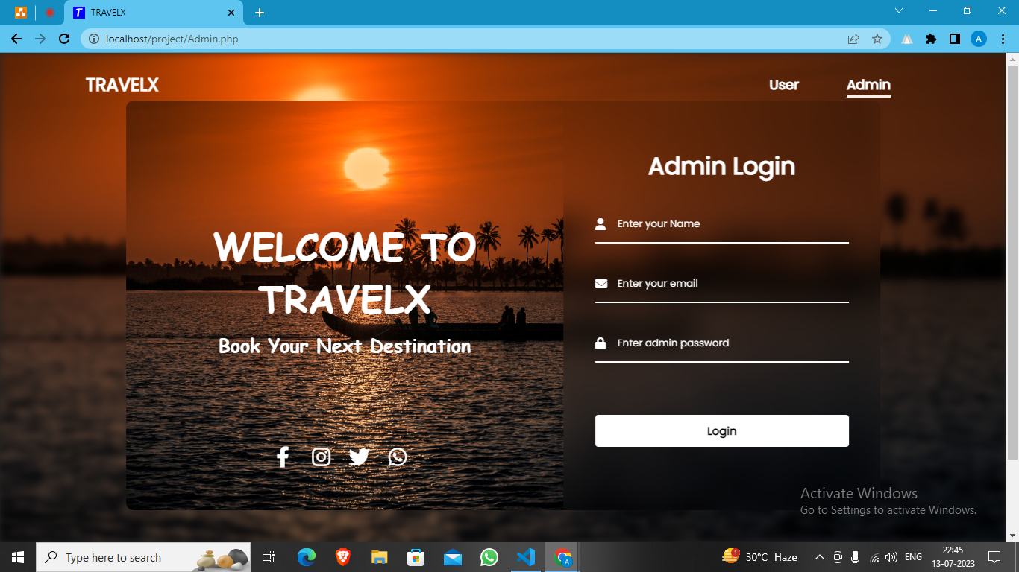
Admin Login

Slide 14
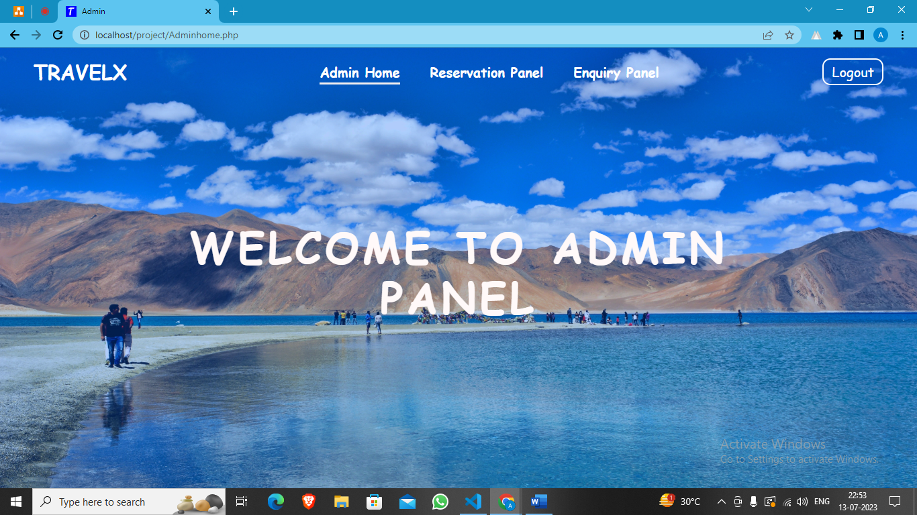
Admin Home Page

Slide 15
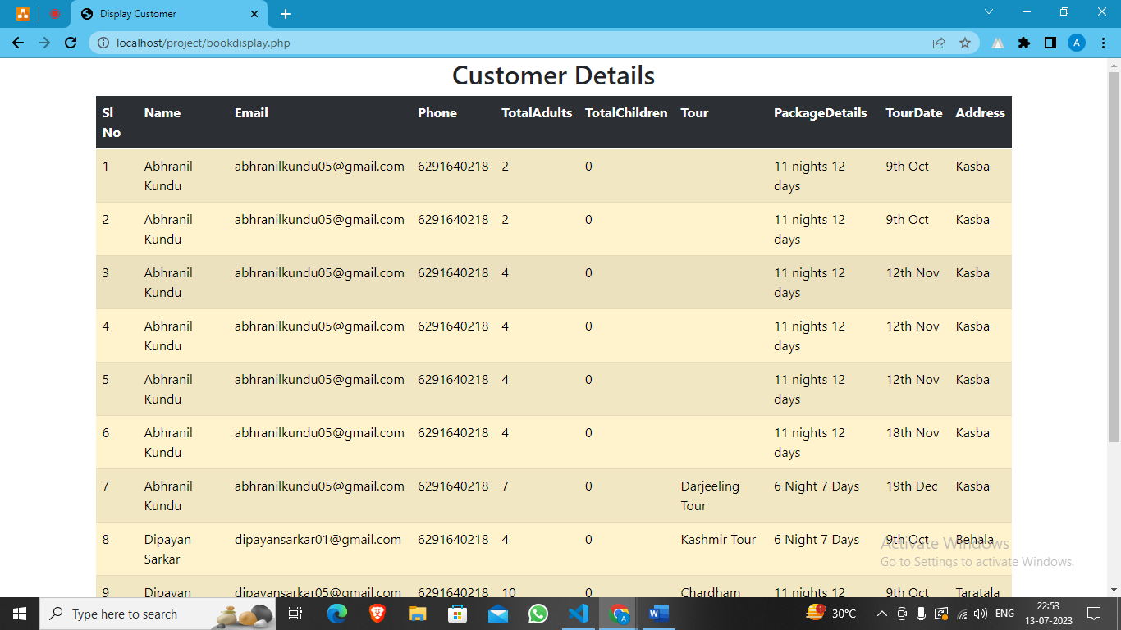
Admin Reservation Panel

Slide 16
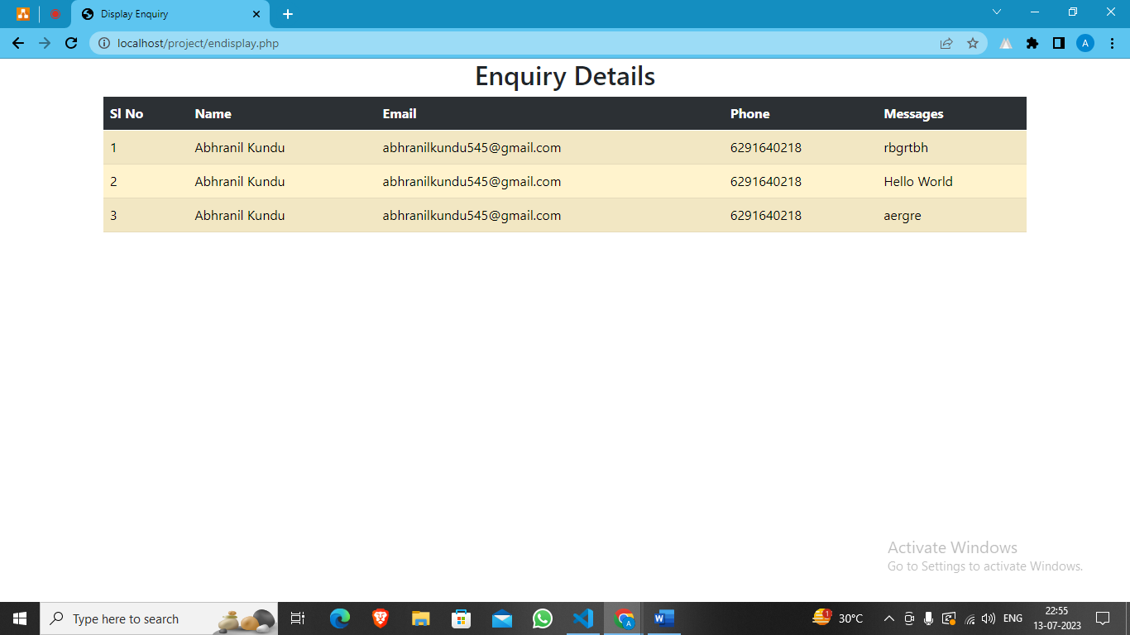
Admin Enquiry Panel

Slide 17
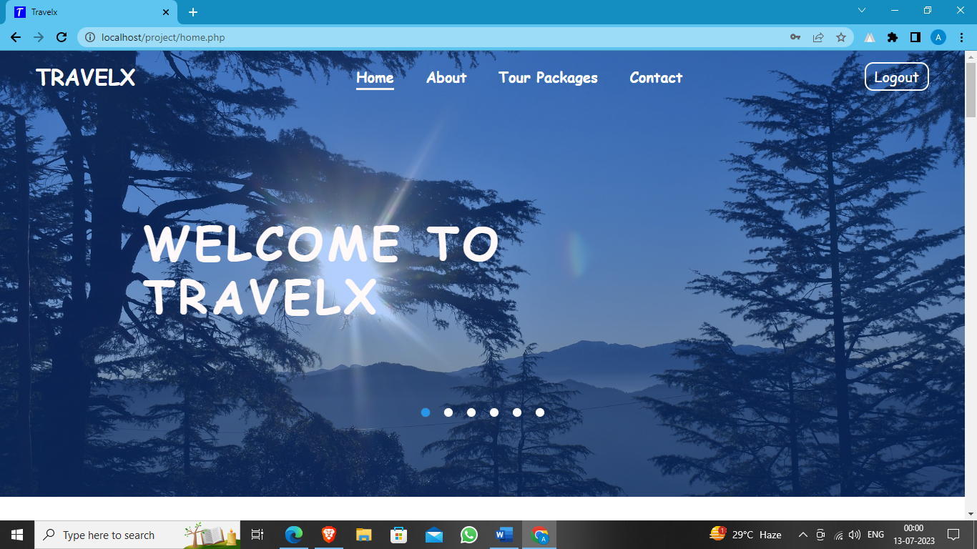
Home Page

Slide 18
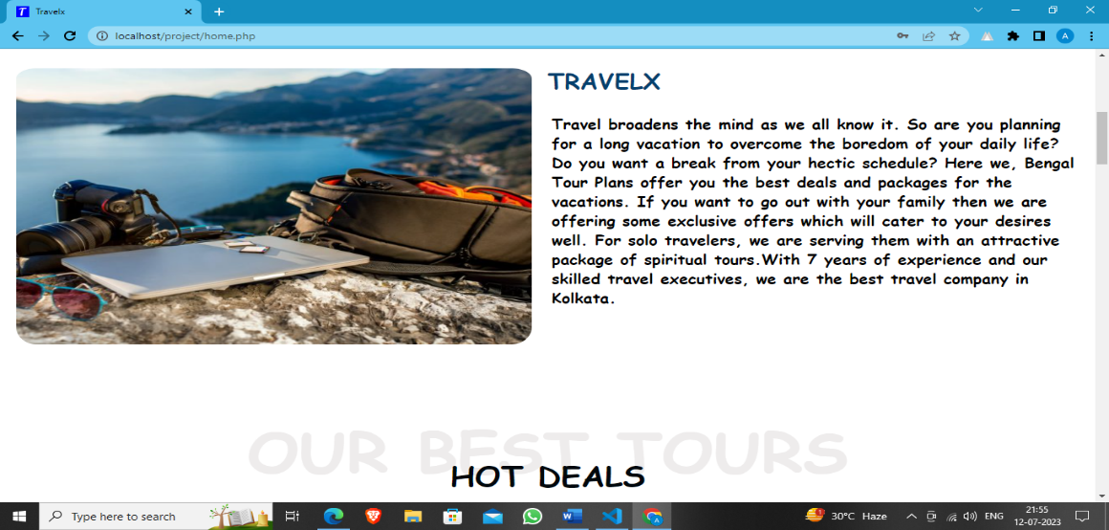
Home Page

Slide 19
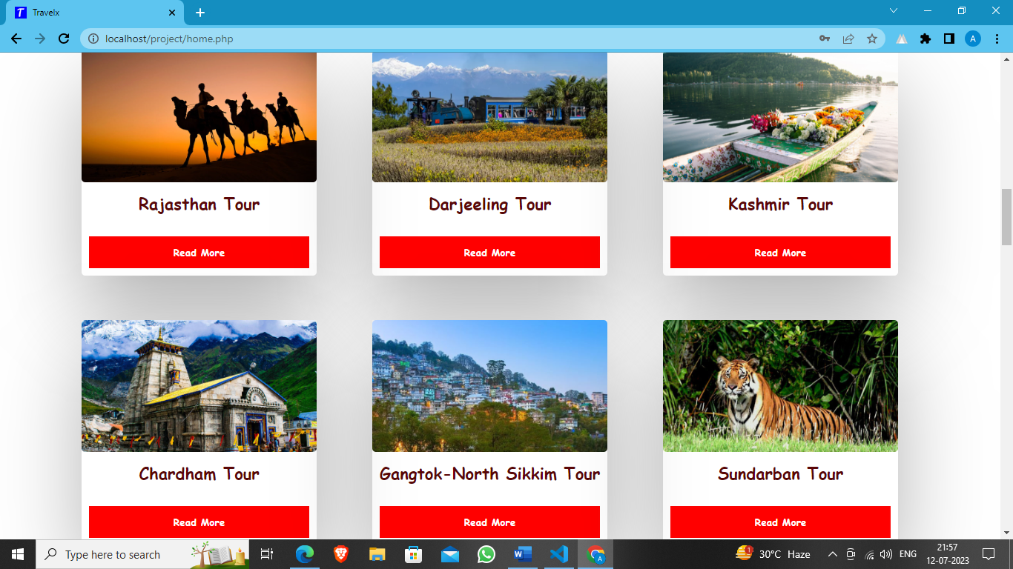
Home Page

Slide 20
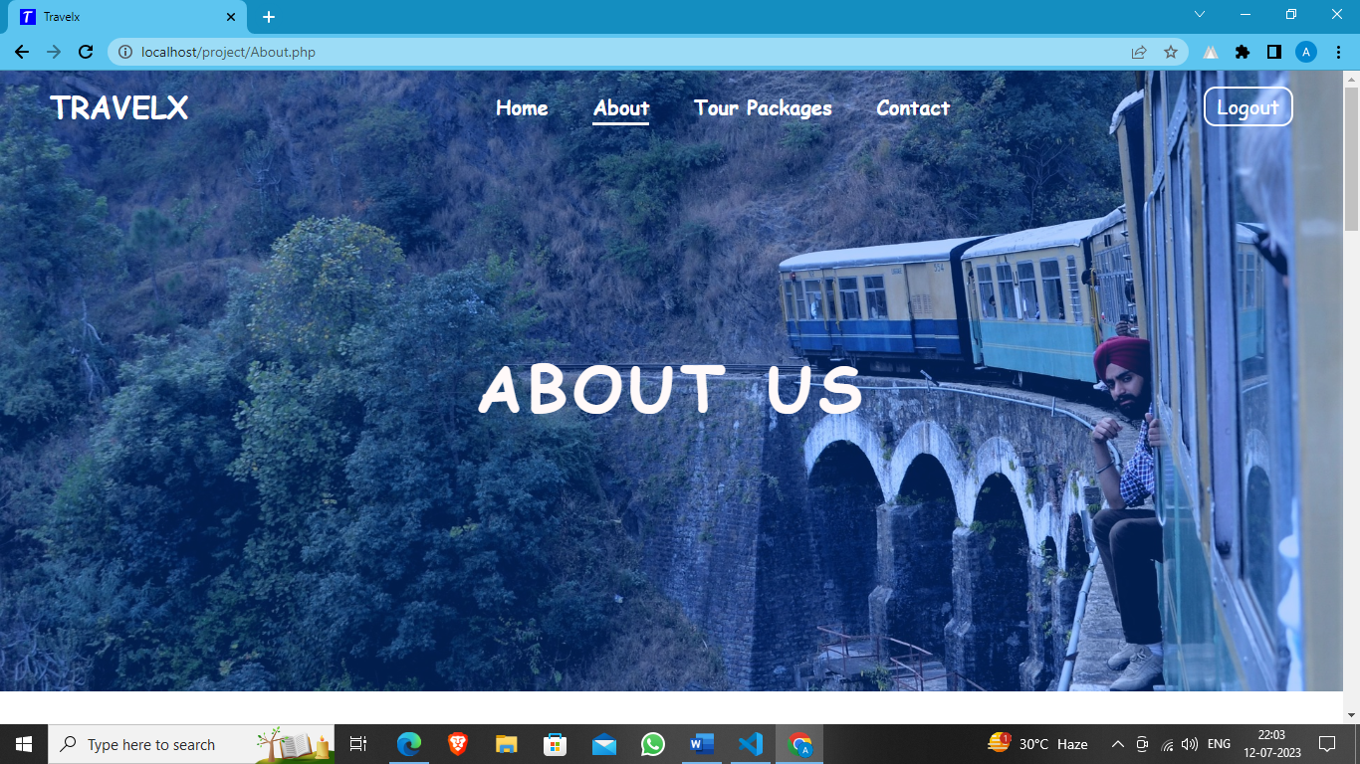
About Us

Slide 21
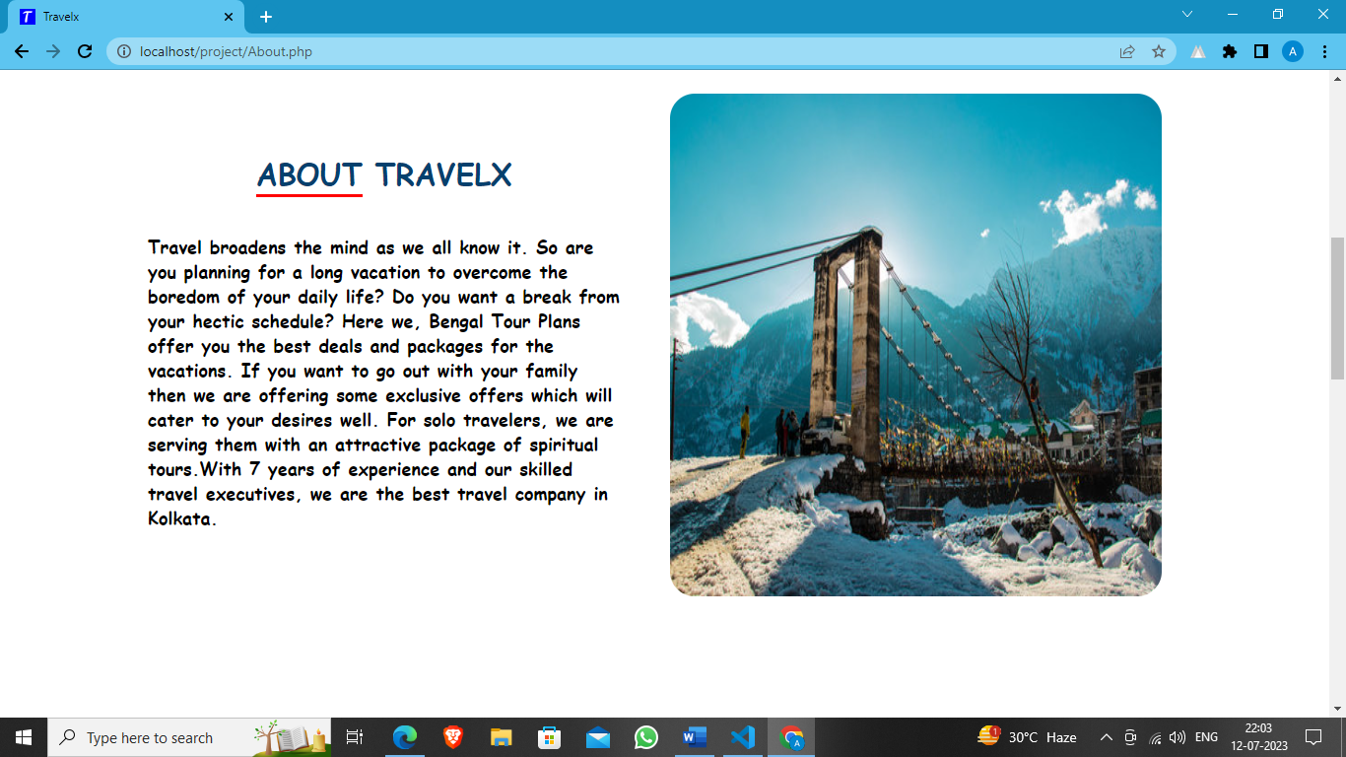
About Us

Slide 22
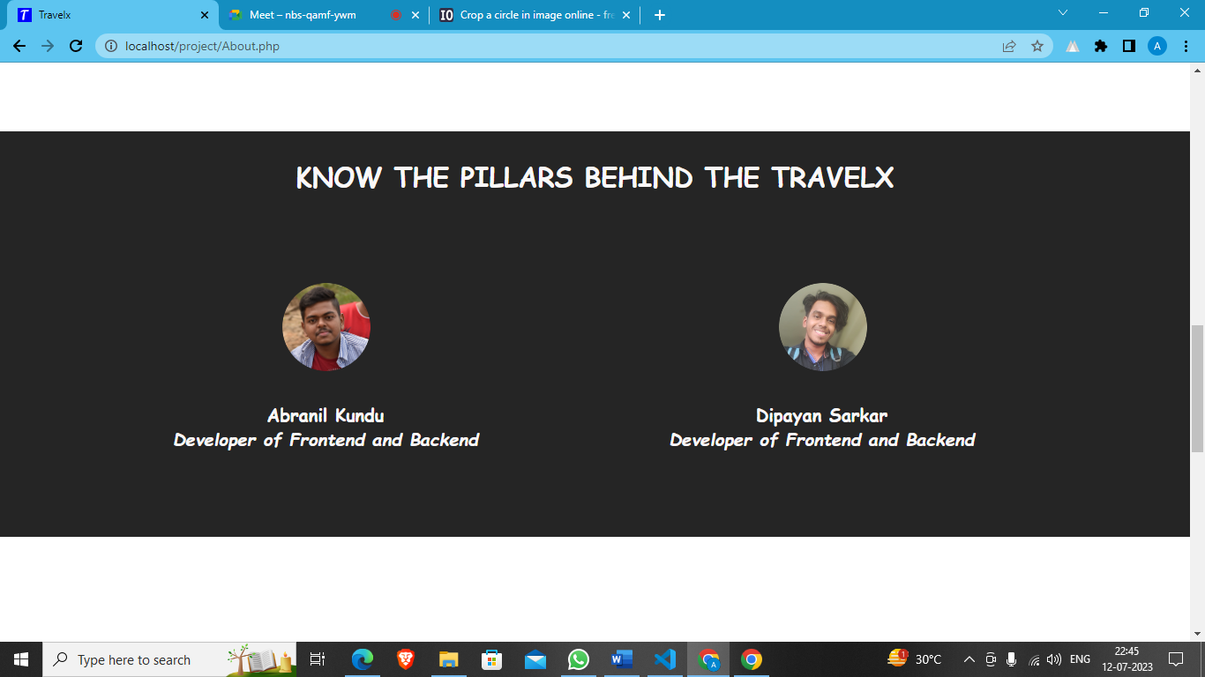
About Us

Slide 23
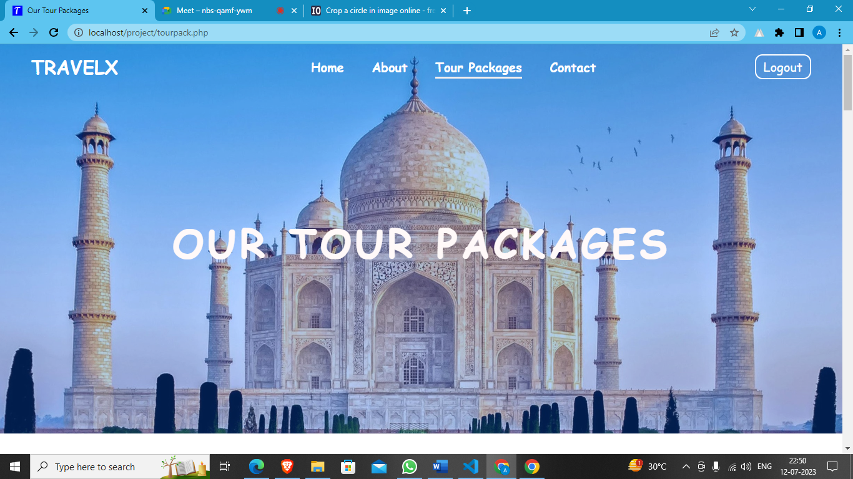
Tour Packages Page

Slide 24
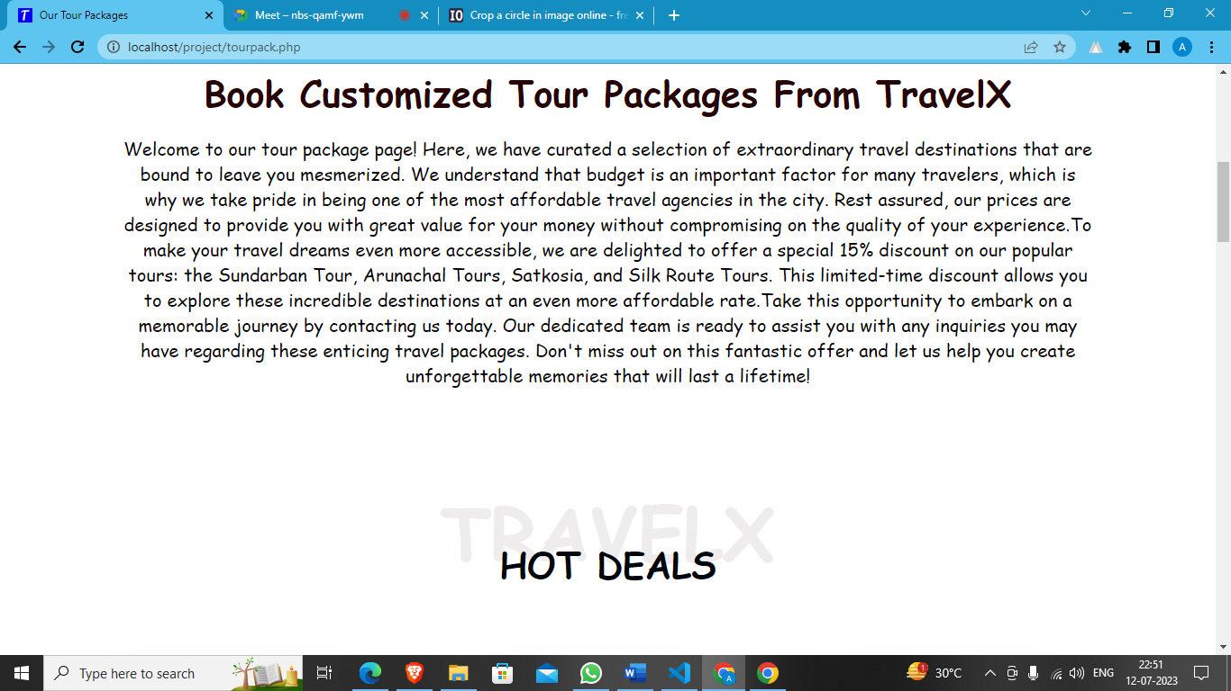
Tour Packages Page

Slide 25
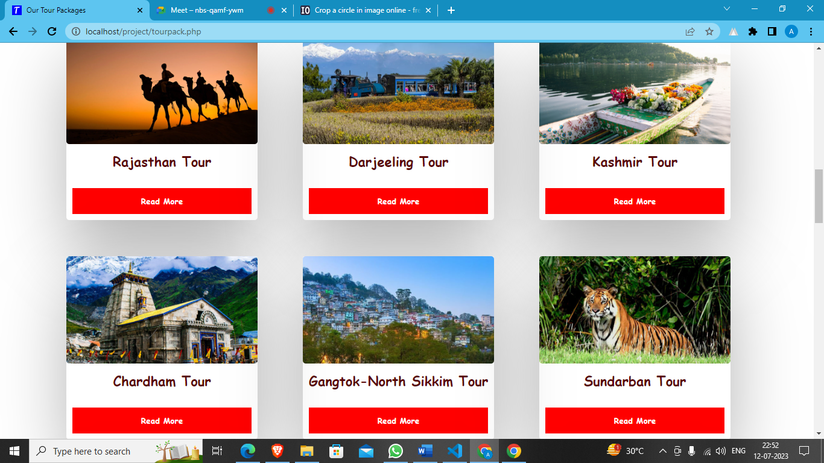
Tour Packages Page

Slide 26
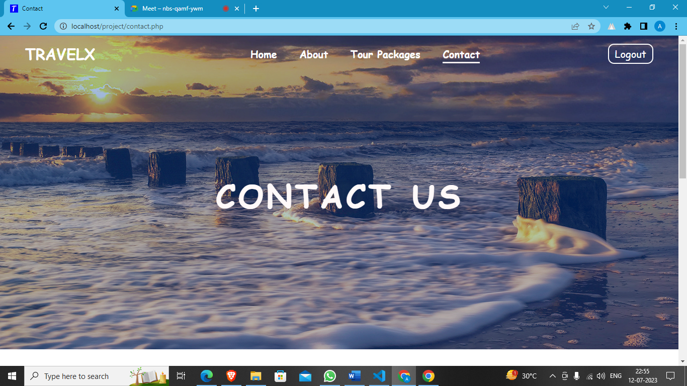
Contact Page

Slide 27
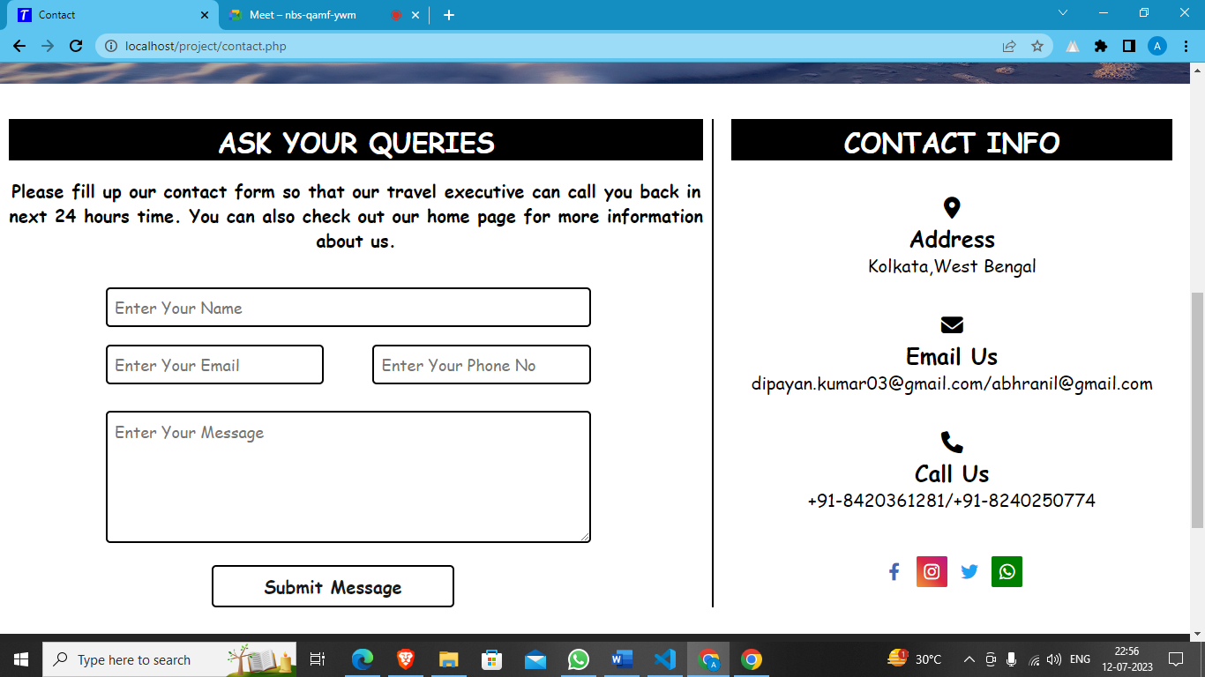
Contact Page

Slide 28
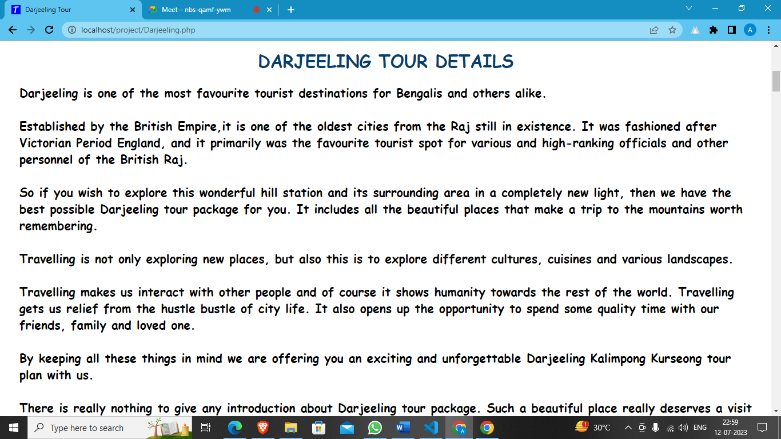
Tour Page for Darjeeling

Slide 29
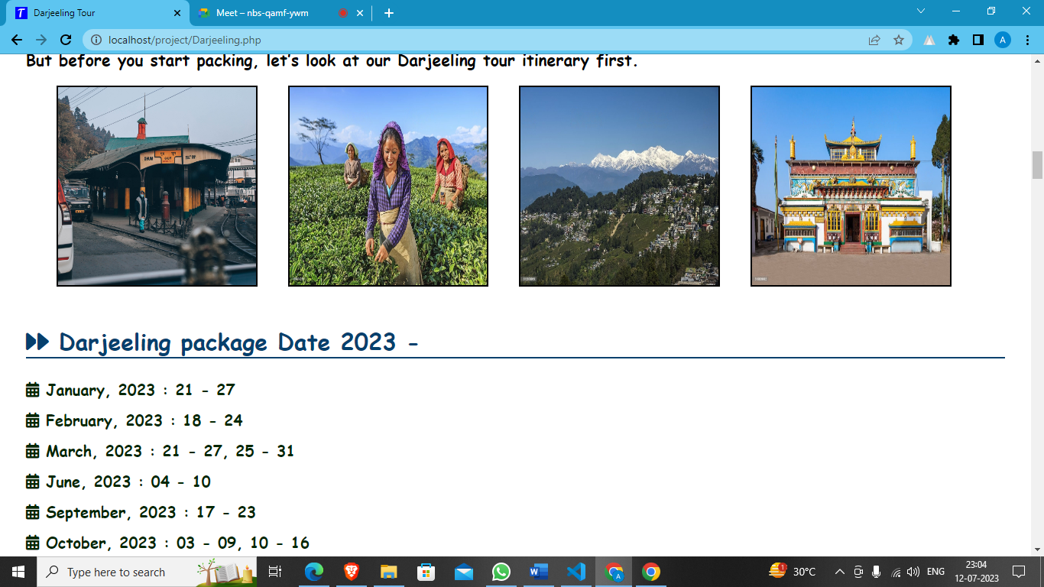
Tour Page for Darjeeling

Slide 30
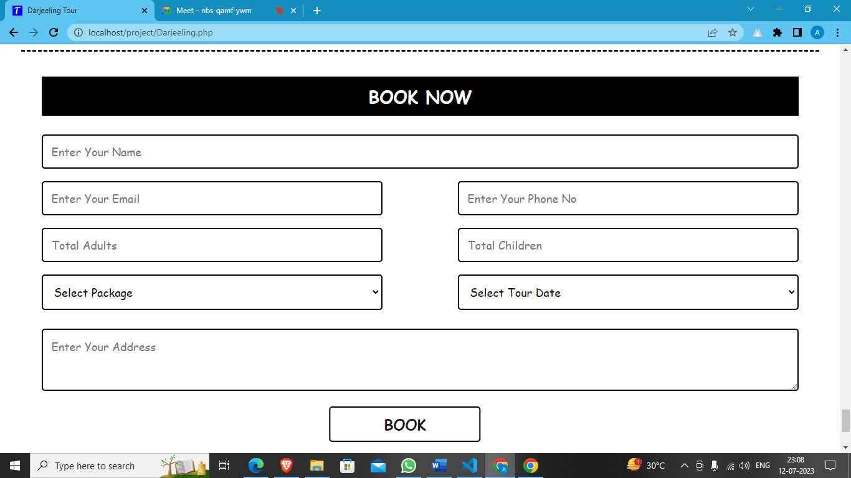
Tour Page for Darjeeling

Slide 31


Future Scope​
This web application involves almost all the basic features of the online Tour and Travel app. The future implementation will be online help for the users and chatting with website administrator.

Slide 32
Conclusion
Tour and travel websites revolutionize trip planning, offering convenience and autonomy. They provide resources to research, compare prices, and make reservations, benefiting both travelers and service providers. Essential tools for simplifying the journey from inspiration to realization.

Slide 33
Bibliography​
https://www.w3schools.com/
https://www.javatpoint.com/
https://www.geeksforgeeks.org/
https://www.canva.com/\

Slide 34

Thank You !

